Slide 1
Online Business Registration System for the Registrar of Companies with AI-Powered Customer Conversational Assistant
Name: Humphrey Asiedu Ocran
Index No: UEMS2900625

Slide 2
Table of Contents
1 | Introduction and Background of the Study
2 | Problem Statement and Research Gap
3 | Aim, Objectives and Research Questions
4 | Significance of the Study
5 | Literature Review and Theoretical Foundation
6 | System Development Methodology
7 | System Design and Architecture
8 | System Implementation
9 | System Testing and Evaluation
10 | Discussion of Findings
11 | Conclusion
12 | Recommendations and Future Work

Slide 3

BACKGROUND TO THE STUDY
Digital tools improve public service delivery.
E-government increases efficiency and transparency.
Business registration is moving online.
Online systems reduce delays and paperwork.
Many platforms still lack real-time advisory support.

Slide 4

PROBLEM STATEMENT
Digital systems often repeat old bureaucracy.
Users face complex legal requirements.
Real-time advisory support is limited.
Rule-based chatbots handle complex queries poorly.
Limited RAG use weakens legal accuracy.

Slide 5
RESEARCH GAP
Conversational AI remains limited in business registration systems.
Existing platforms focus mainly on form submission, not legal guidance.
There is a need for a RAG-based system that combines registration services with legally grounded advisory support.

Slide 6

AIMS & OBJECTIVES
To design, develop, and evaluate an online business registration system integrated with a Retrieval-Augmented Generation conversational agent grounded in the Ghana Companies Act to provide automated advisory services.
The study sought to:
Design a digital web portal for online submission of business registration forms and documents.
Develop a RAG pipeline for retrieving relevant legal information from the Ghana Companies Act.
Implement a conversational AI assistant for real-time advisory and navigation support.
Evaluate system effectiveness using usability, task completion, and performance indicators.

Slide 7

RESEARCH QUESTIONS
How can a digital web portal support online submission of registration forms and documents?
How can a RAG pipeline retrieve and present relevant legal information?
How can a conversational AI assistant provide real-time advisory support?
How effective is the system in terms of usability, task completion, and system performance?

Slide 8

SIGNIFICANCE OF THE STUDY
Improves digital business registration service delivery.
Provides real-time legal and procedural guidance.
Reduces user confusion and submission errors.
Demonstrates AI application in public sector service innovation.
Supports digital governance, transparency, and accessibility.
Provides a prototype model for intelligent e-government systems.

Slide 9
LITERATURE REVIEW
Literature Theme | Scholarly Insight | Key Reference
Business Registration Systems | Registration systems shape business formalization and regulatory compliance. | Klapper & Love (2011)
Online Business Registration | Digital platforms improve efficiency but may reproduce bureaucratic complexity. | World Bank (2020)
AI in Public Service Delivery | AI strengthens automation, responsiveness, and data-driven public administration. | Wirtz et al. (2020)
Conversational AI and Chatbots | Chatbots improve service interaction but often lack legal and contextual depth. | Adamopoulou & Moussiades (2020)
AI in digital government | AI enhances service personalization | Savelli et al. (2025)

Slide 10

CONCEPTUAL FOUNDATION
The proposed system combines:
Online registration platform
Digital form submission
Document upload and management
RAG-based legal retrieval
Conversational AI support
User-centred digital government service delivery

Slide 11
THEORETICAL FRAMEWORK
Theory | Relevance to the Study
Technology Acceptance Model | Explains user acceptance of the digital platform
Diffusion of Innovation Theory | Explains adoption of AI-enabled public service innovation
Socio-Technical Systems Theory | Explains interaction between users, technology, and institutions

Slide 12
SIGNIFICANCE OF THE STUDY
Improves digital business registration service delivery.
Provides real-time legal and procedural guidance.
Reduces user confusion and submission errors.
Demonstrates AI application in public sector service innovation.
Supports digital governance, transparency, and accessibility.
Provides a prototype model for intelligent e-government systems.

Slide 13
SYSTEM DEVELOPMENT METHODOLOGY
The study adopted a hybrid methodology combining Design Science Research (DSR)
and Agile software development.
Methodological Element | Application in the Study
Design Science Research | Guided the creation and evaluation of the system as a functional research artifact.
Agile Development | Supported iterative development through short sprints and continuous refinement.
User Stories | Converted stakeholder needs into system functions such as login, form submission, upload, tracking, and chatbot support.
Product Backlog | Organized and prioritized system features for phased implementation.
Testing and Feedback | Enabled continuous functional, usability, and performance evaluation.

Slide 14
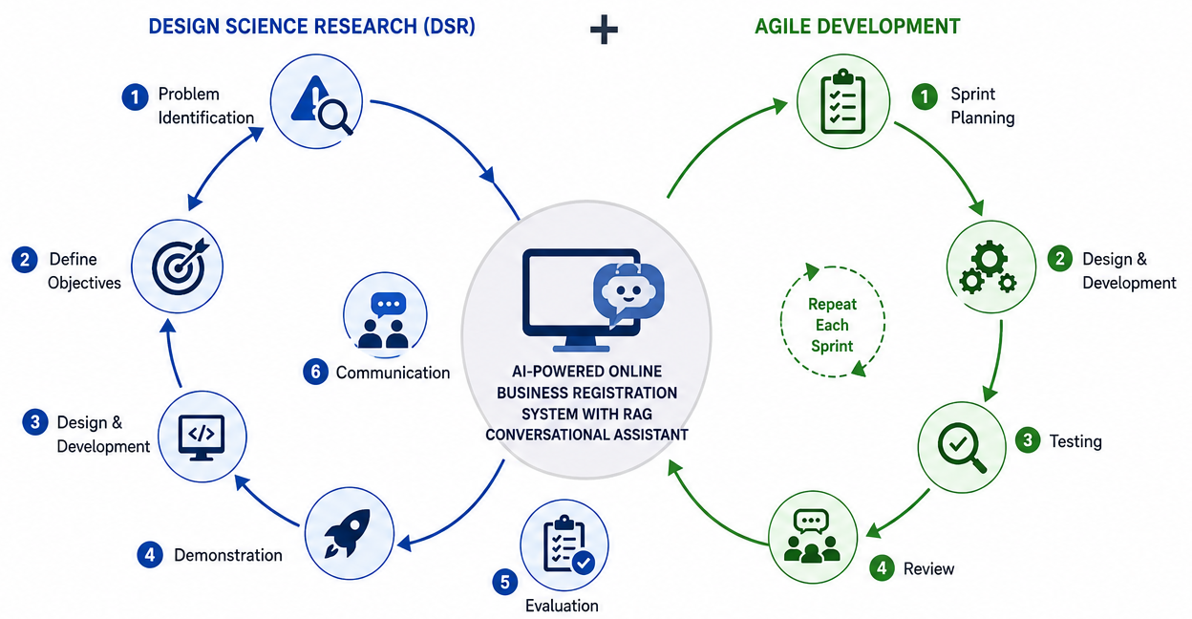

Slide 15
STAKEHOLDER ANALYSIS
Stakeholder | Role in the System
Business owners | Submit registration applications
Registrar officers | Review and manage applications
System administrator | Manage users and system operations
AI chatbot | Provides automated advisory support
Government institution | Oversees digital registration service

Slide 16
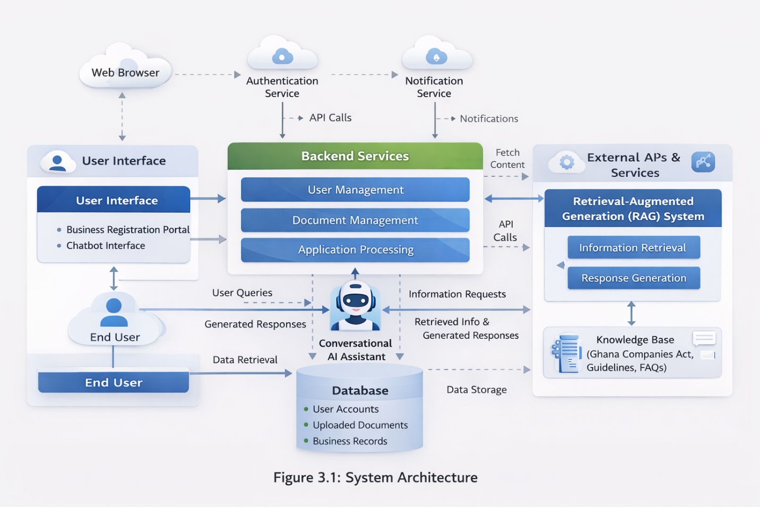
SYSTEM
ARCHITE-CTURE

Slide 17
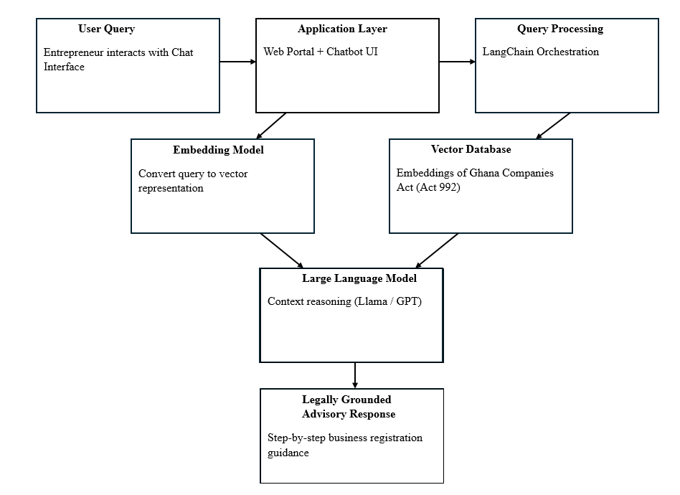
LLM + Vector Database Pipeline

Slide 18
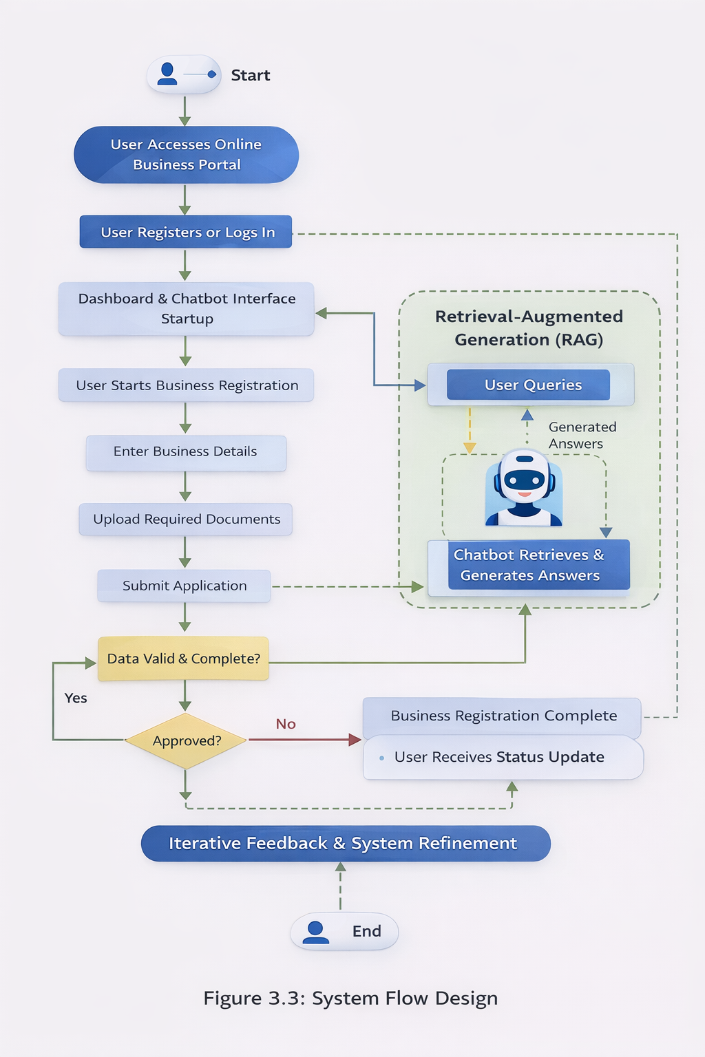
SYSTEM FLOW

Slide 19
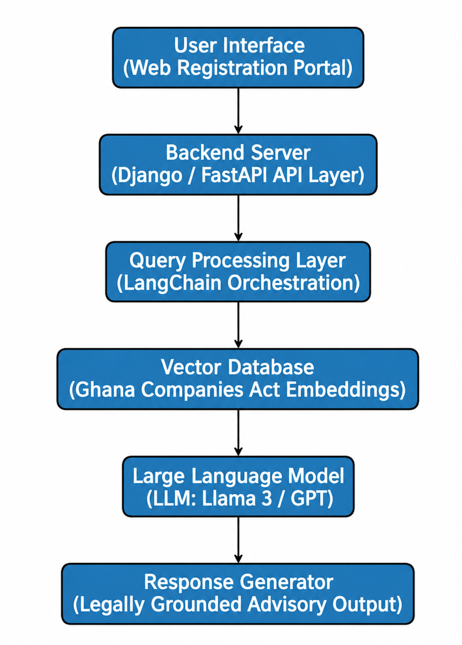
RAG SYSTEM ARCHITECTURE DIAGRAM

Slide 20
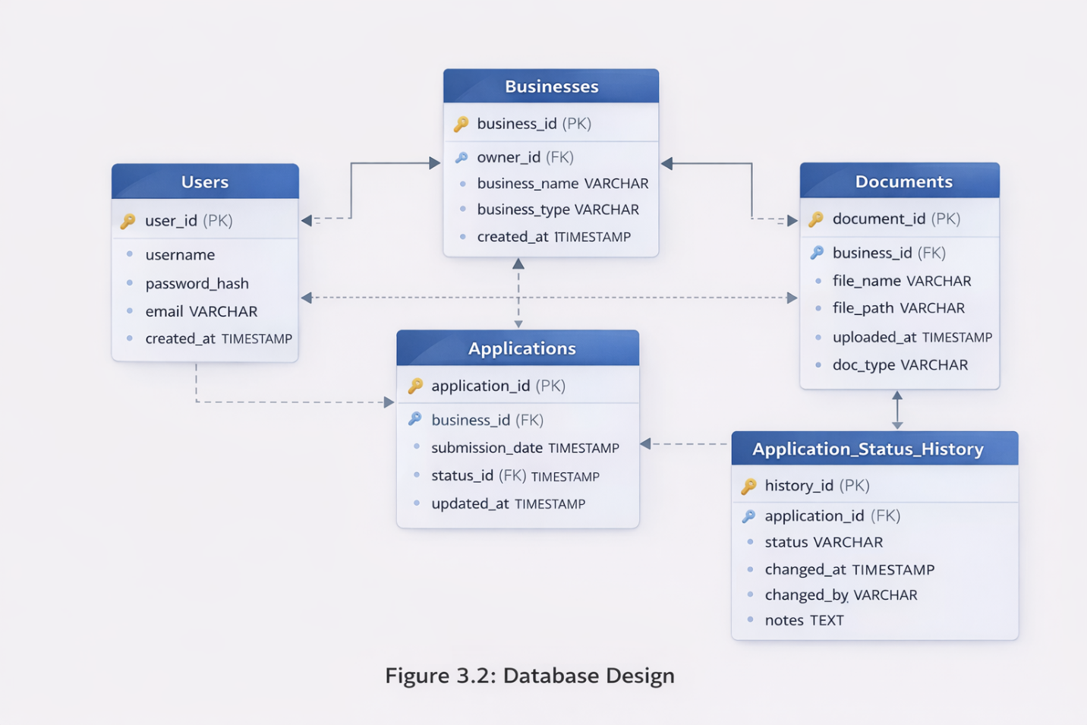
DATABASE
DESIGN

Slide 21
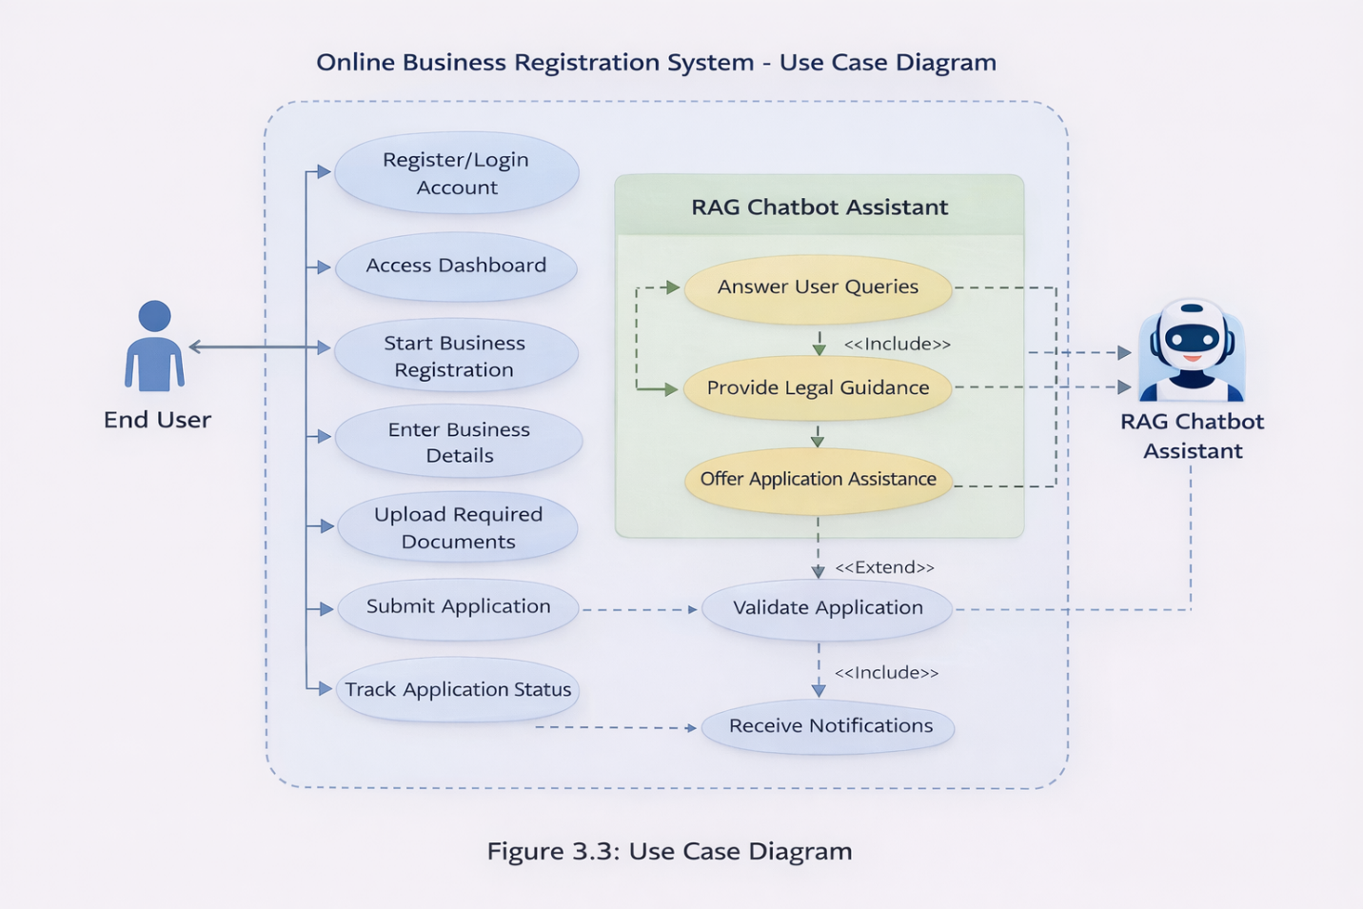
USE CASE
DIAGRAM

Slide 22
SYSTEM REQUIREMENTS
Functional Requirements
Non-Functional Requirements
Register and authenticate users
Capture business registration details
Allow document upload
Track application progress
Provide chatbot-based advisory support
Retrieve relevant legal information from the Ghana Companies Act
Usability
Security
Reliability
Responsiveness
Data consistency
Accessibility
Scalability for future institutional deployment

Slide 23

DEVELOPMENT TOOLS USED
Front-end: HTML, CSS, JavaScript, Bootstrap
Back-end: Django / Python
Database: Superbase
AI/RAG Tools: LangChain, embeddings, ChromaDB, LLM
Evaluation: Functional testing, SUS, task completion, performance testing

Slide 24
SYSTEM IMPLEMENTATION

Slide 25
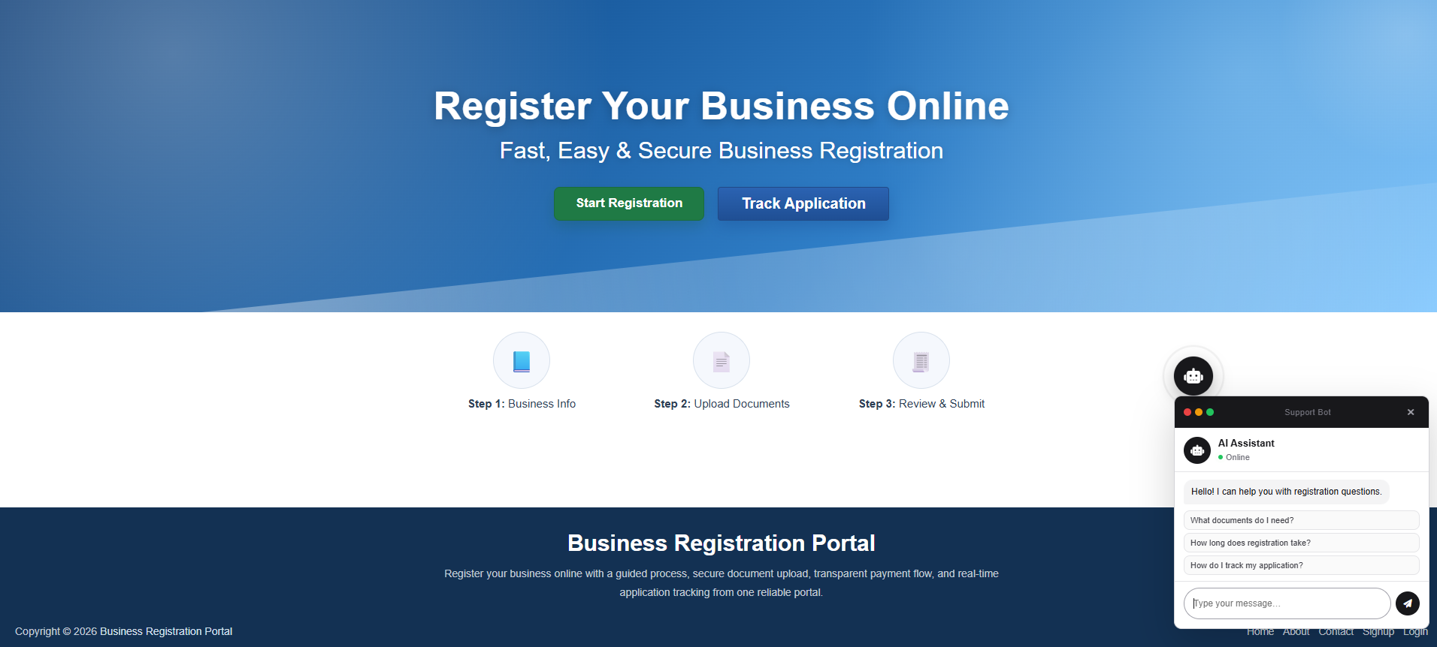
SYSTEM HOME PAGE INTERFACE

Slide 26
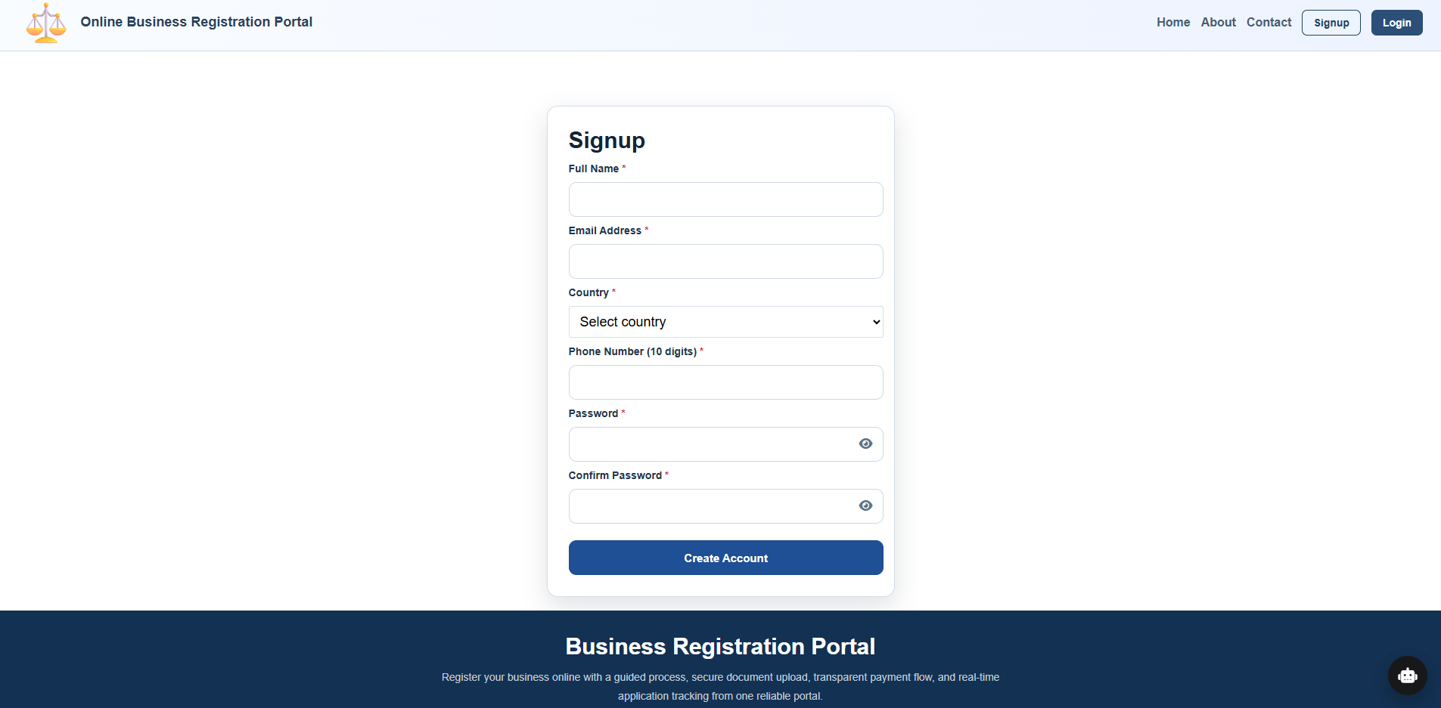
SIGNUP

Slide 27
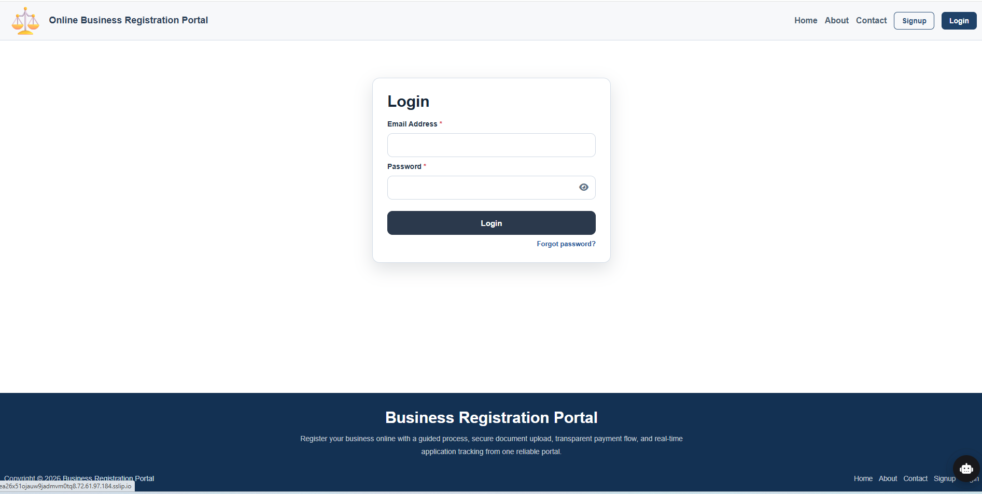
LOGIN

Slide 28
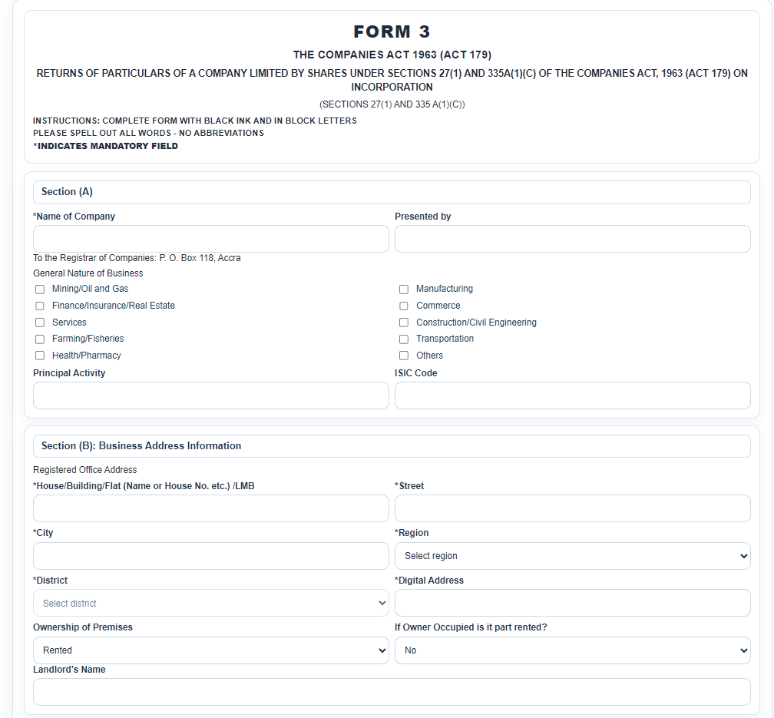
BUSINESS REGISTRATION FORM INTERFACE

Slide 29
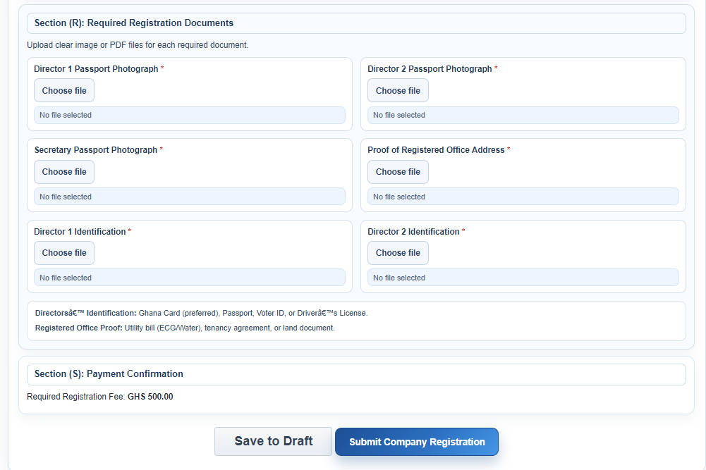
DOCUMENT UPLOAD PAGE

Slide 30
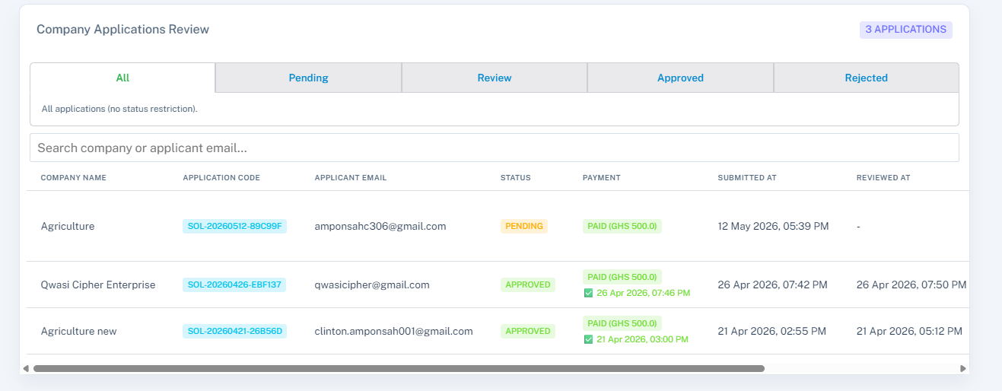
UPLOADED DOCUMENTS MANAGEMENT DASHBOARD

Slide 31
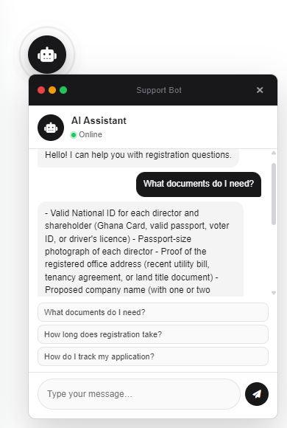
SAMPLE CHATBOT CONVERSATION OUTPUT

Slide 32
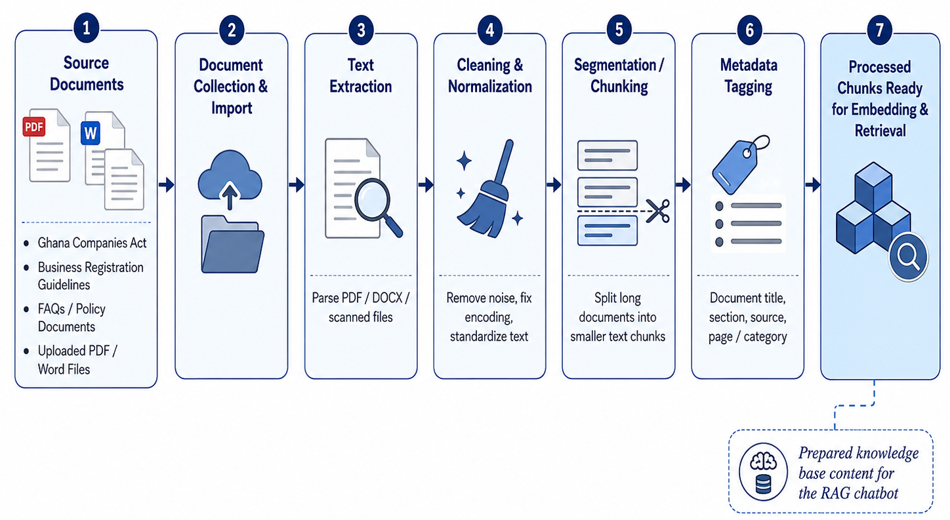
DOCUMENT INGESTION AND PREPROCESSING WORKFLOW

Slide 33
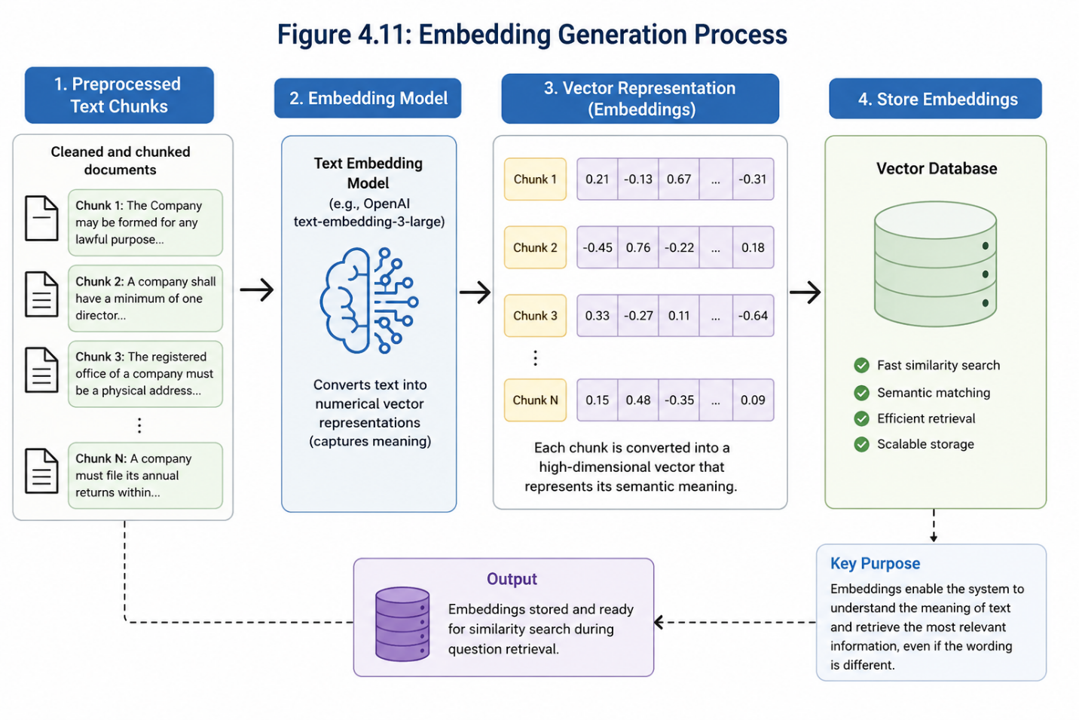
EMBEDDING GENERATION PROCESS

Slide 34
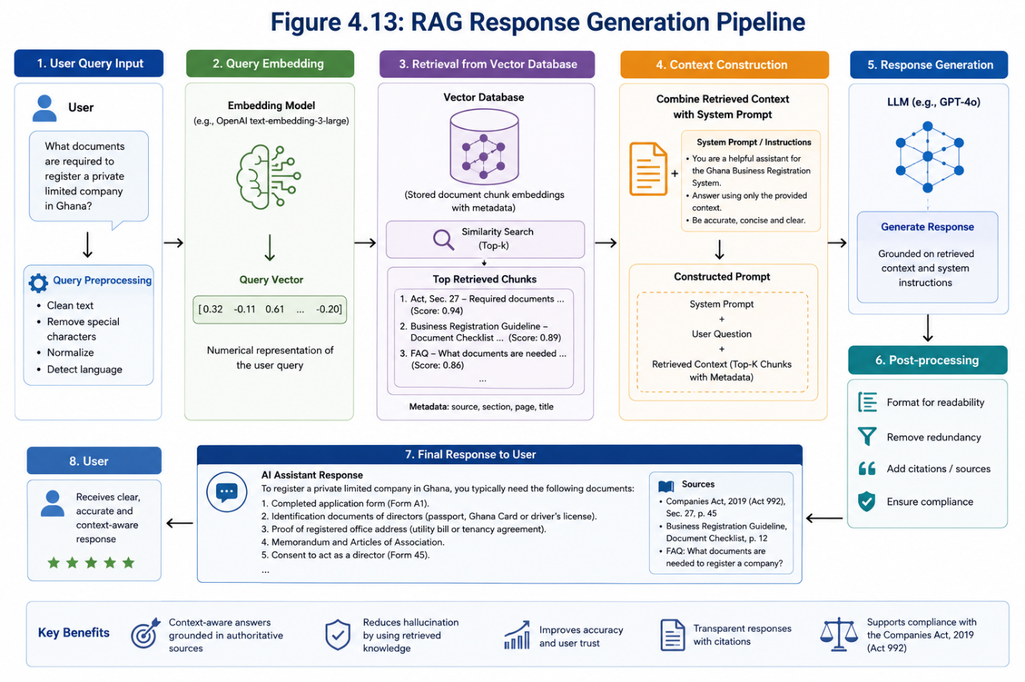
RAG RESPONSE GENERATION PIPELINE

Slide 35
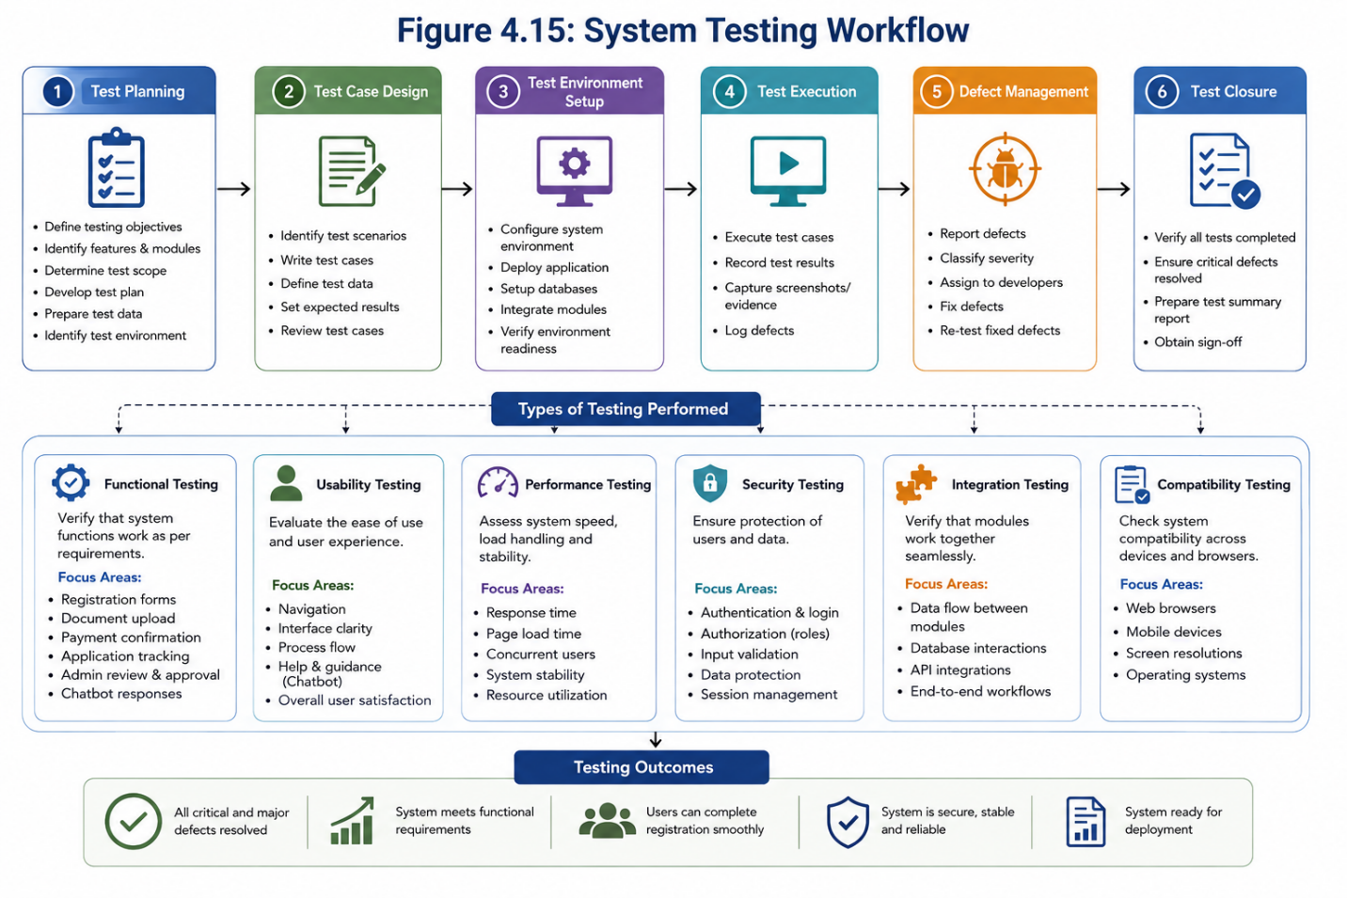
System Testing Workflow

Slide 36
FUNCTIONAL TESTING RESULTS
Test Case | Expected Outcome | Actual Outcome | Status
User Registration | User account created successfully | Successful | Pass
User Login | Authenticated access granted | Successful | Pass
Document Upload | Files uploaded successfully | Successful | Pass
Form Submission | Registration form submitted | Successful | Pass
Chatbot Query | Relevant response generated | Successful | Pass
Application Tracking | Status displayed correctly | Successful | Pass

Slide 37
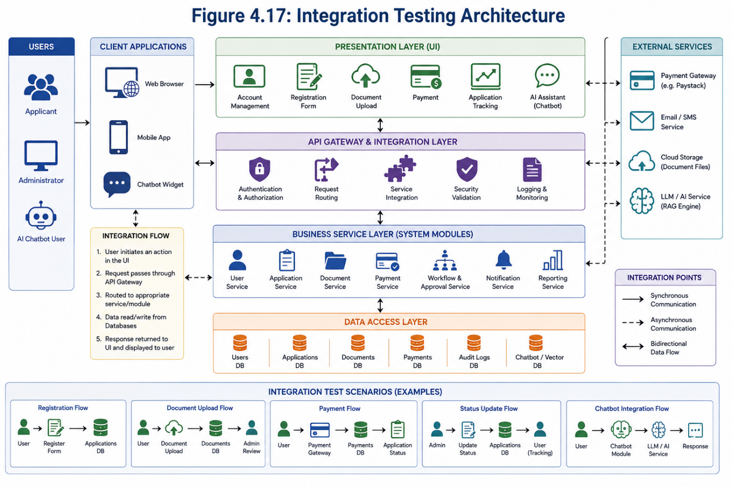
Integration Testing Architecture

Slide 38
Objective One: Digital Web Portal Design
The portal supported user registration and login.
Business forms were digitized for online submission.
Document upload reduced paper-based processes.
Application tracking improved transparency.
The system demonstrated potential to simplify business registration workflows

Slide 39
Objective Two: RAG Pipeline Development
Legal documents were processed into retrievable knowledge units.
Vector-based search improved semantic retrieval.
The system retrieved relevant legal content from the Ghana Companies Act.
Retrieval accuracy supported reliable advisory responses.
RAG reduced dependence on predefined chatbot answers

Slide 40
Objective Three: Conversational AI Assistant
The chatbot provided real-time user support.
It assisted users with registration-related questions.
It improved navigation within the platform.
It provided legal and procedural explanations.
It enhanced user interaction with the digital platform

Slide 41
Objective Four: System Evaluation
The SUS score of 85.8 indicated excellent usability.
Average response time showed good system responsiveness.
99% availability indicated strong prototype reliability.
Retrieval accuracy of 92% supported advisory relevance.
Testing confirmed the feasibility of the proposed system

Slide 42

CONCLUSION
Business registration can be made more accessible through digital platforms.
RAG can improve legal information retrieval and advisory accuracy.
Chatbots can provide real-time user support.
The platform can reduce procedural complexity and improve user experience.
AI-enabled systems can support more intelligent digital government service delivery

Slide 43
RECOMMENDATION & FUTURE WORK
Multilingual chatbot support
Government agencies should adopt intelligent support systems in digital service platforms
The Registrar of Companies should consider AI-assisted advisory tools for user guidance
The RAG knowledge base should be continuously updated with current legal and procedural documents

Slide 44
References
Adamopoulou, E., & Moussiades, L. (2020). Chatbots: History, technology, and applications. Machine Learning with Applications, 2, 100006.
Gil-Garcia, J. R., Zhang, J., & Puron-Cid, G. (2016). Conceptualizing smartness in government: An integrative and multidimensional view. Government Information Quarterly, 33(3), 524–534.
Klapper, L., & Love, I. (2011). The impact of business environment reforms on new firm registration. World Bank Policy Research Working Paper No. 5493.
Wirtz, B. W., Weyerer, J. C., & Sturm, B. J. (2020). The dark sides of artificial intelligence: An integrated AI governance framework for public administration. International Journal of Public Administration, 43(9), 818–829.
World Bank. (2020). Doing Business 2020: Comparing business regulation in 190 economies. World Bank.
Savelli, I., Rigou, M., & Balaskas, S. (2025). From e-government to AI e-government: A systematic review of citizen attitudes. Informatics, 12, 98.

Slide 45


